Slide 1
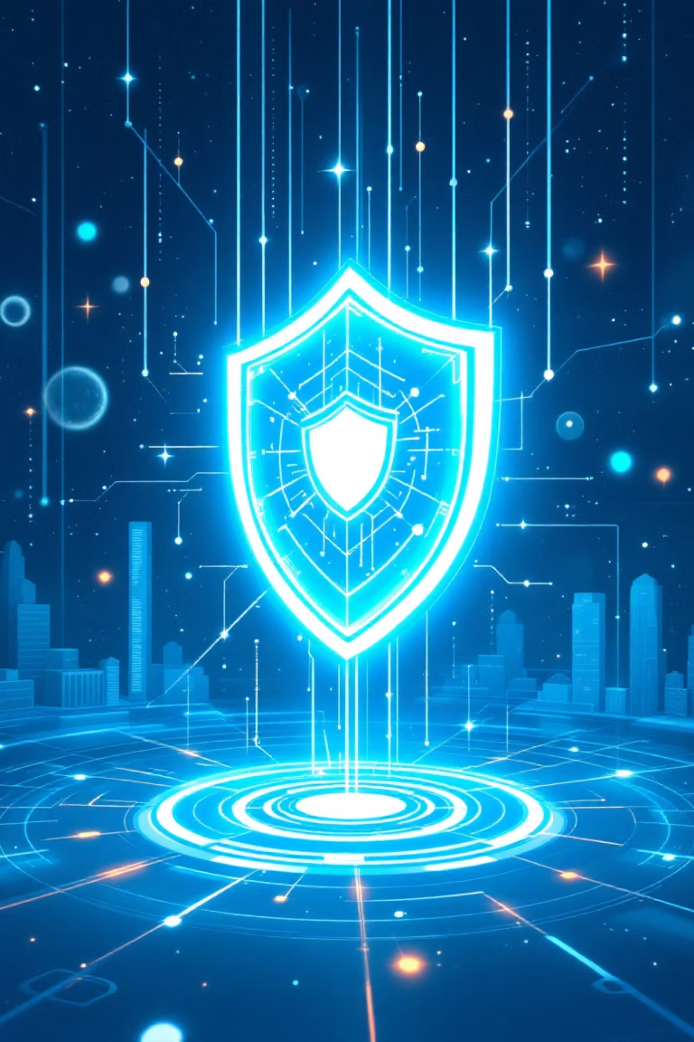
Reality-Lag Security: Temporal Shadow Defense with Self-Healing and Reverse Engineering
CyberNova | Vibeaiathon 2025
"Turning cyber attacks into illusions — where hackers think they win, but only lose."

Slide 2
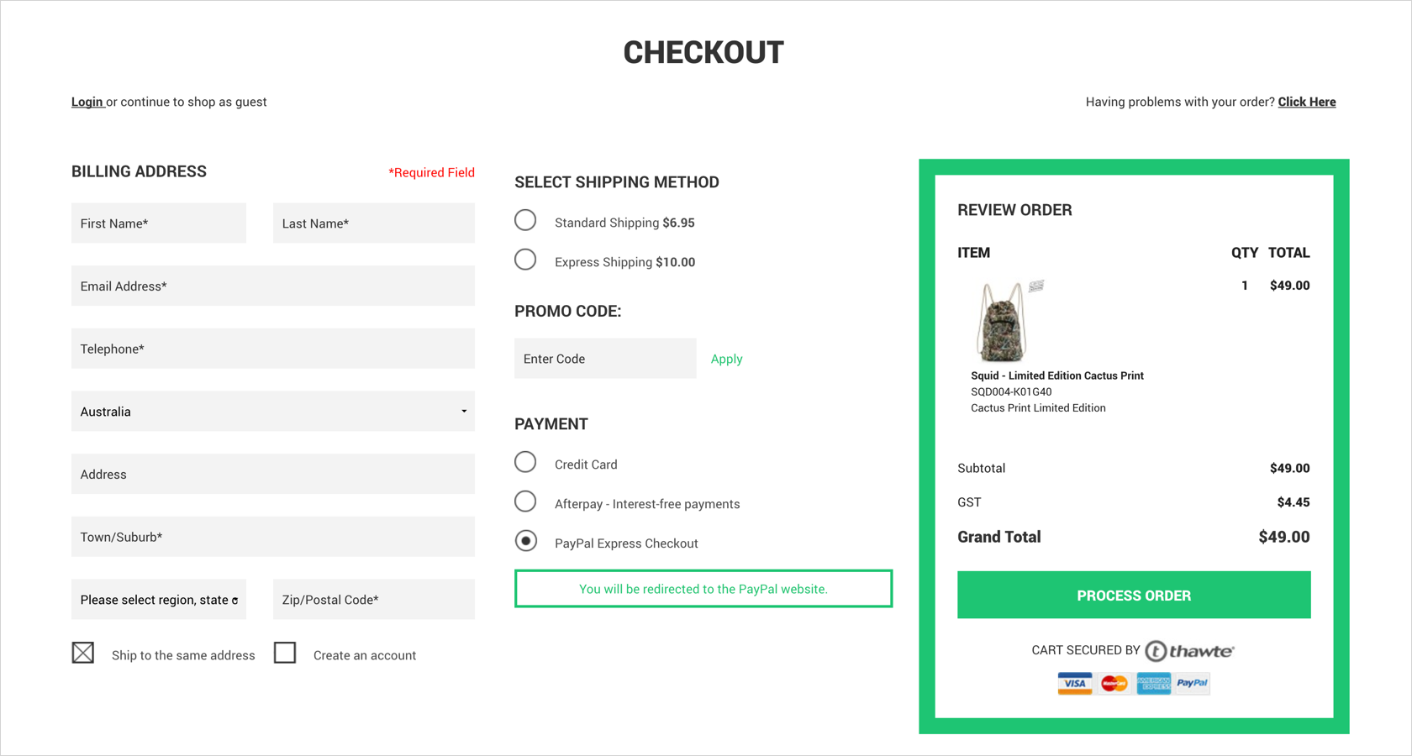
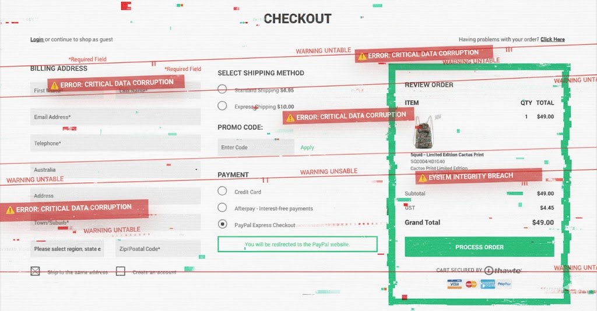

What if reality itself became your firewall?
A split digital world —
“Breached Reality” → distorted screens, glitch overlays, leaking data.
“Secure Reality” → happy users, green shields, normal transactions.

Slide 3

The Problem :
Cyber defense is stuck in a loop — detect, block, repeat — but attackers evolve faster than systems can patch.
The Illusion of Safety in a Breached World
The Scale of Deception
The Failed Defense Model
The Real Problem
Millions lost every second—not from big exploits, but tiny manipulations
Traditional security tries to block or detect—but falls short
Once breached, attackers control perception itself
Firewalls: breached perimeters
Truth becomes compromised
₹9000 → ₹900 price alterations
IDS: reactive, not preventive
Attackers evolve faster than patches
Falsified account balances
Honeypots: static, predictable
Detection comes too late
Exploited query parameters
"What if reality itself became your firewall?"
100%
Introducing Reality-Lag Security
Where attackers are trapped inside illusions, not systems.
Perception Control
A paradigm shift from reactive detection to proactive deception—controlling what breached attackers see, touch, and believe.
Attackers operate in your reality

Slide 4



Our Innovation: Dual-Timeline Deception Architecture
Reality-Lag Security creates two parallel universes—a true timeline for legitimate users and a shadow timeline where attackers are trapped in an evolving, hyper-realistic illusion.
True Timeline
Real users interact with authentic systems, data, and APIs seamlessly
Shadow Timeline
Suspicious actors encounter convincing fake environments with synthetic data
Temporal Distortion
Time lags, delays, and fast-forwards distort attacker perception
When deception is suspected, attackers descend into deeper shadow layers—"Inception Mode"—while the real system self-heals and reverse-engineers their payloads safely.

Slide 5
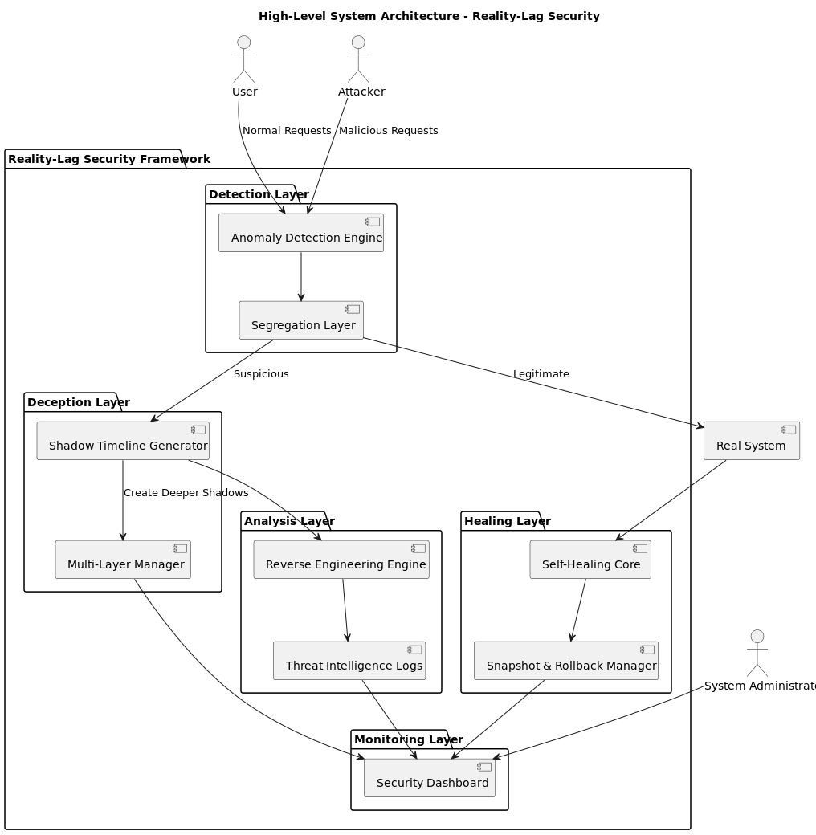
Impressive PowerPoint Points
Reality-Lag Security (RLS): An advanced cybersecurity framework that actively deceives and neutralizes threats.
Dual-Timeline Defense: Diverts attackers to a simulated "shadow timeline" for analysis, keeping the real system secure and operational.
Self-Healing & Autonomous: The system automatically patches and restores itself to ensure zero impact from attacks.
Perception Warfare: It's not passive defense—it's an active system that traps and analyzes attackers in a controlled illusion.

Slide 6
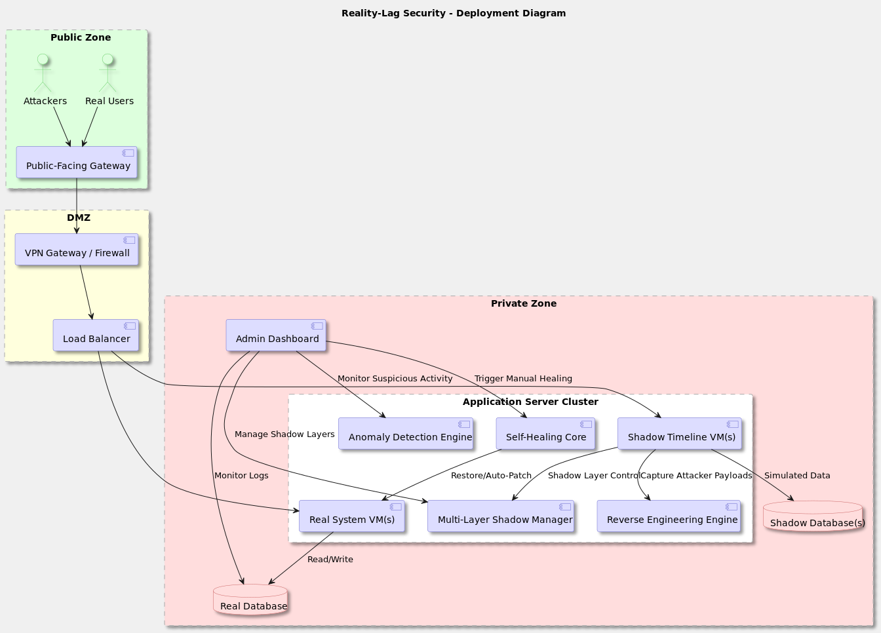

Slide 7





Novel Technical Capabilities
Payload Intelligence
Safe reverse engineering captures attacker techniques for predictive defense
Multi-Shadow Illusion
Self-Healing Engine
Temporal Deception
Dynamically generated fake environments that adapt to attacker behavior in real-time
Automatic transaction rollback and system restoration without human intervention
Time-based manipulation creates cognitive confusion preventing breakthrough attempts

Slide 8
E-Commerce platforms
Healthcare systems
Government defense agencies
Cloud service providers
Cybersecurity enterprises
Desirability:
Solving Critical Pain Points
Zero Downtime
Complete Data Protection
Attacks never disrupt legitimate operations—
shadow environments absorb all malicious activity
100% prevention of data exfiltration through
convincing synthetic responses
Threat Intelligence
Research Asset
Every attack becomes a learning opportunity, building
predictive defense capabilities
Controlled attack simulations provide invaluable
insights into emerging threat vectors
Paradigm Shift: Transform cybersecurity from "blocking threats" to "trapping and learning from threats"

Slide 9
Technical Feasibility: Built on Proven Technologies
01
02
Gateway & Detection
Backend Intelligence
React/Vue.js frontend with real-time behavioral analysis
Node.js/Express.js microservices with event-driven architecture
03
04
Dual Database Layer
AI Detection Engine
MongoDB for real and shadow data stores with instant replication
Python-based ML for anomaly detection and behavioral clustering
05
06
Shadow Orchestration
Reverse Engineering
Docker/Kubernetes for dynamic container deployment at scale
Sandboxed Python environment for safe payload analysis and extraction
Resources Required: Prototype feasible with standard cloud infrastructure. Enterprise deployment leverages auto-scaling for unlimited shadow environments without proportional cost increases.

Slide 10
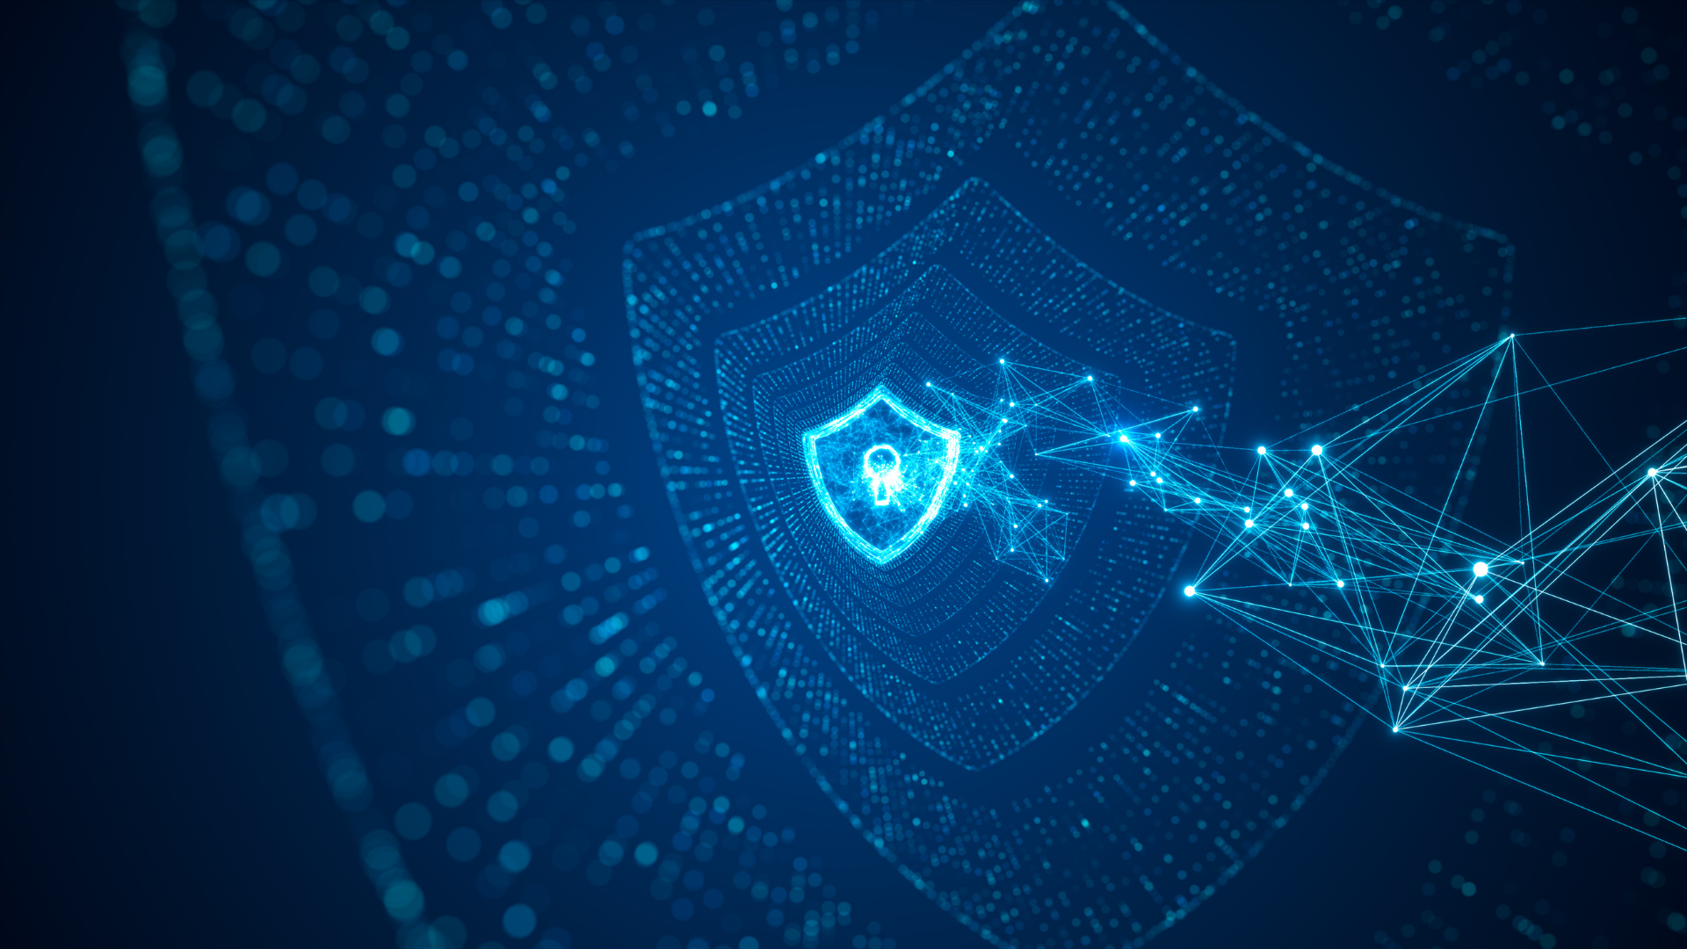
Market Viability: Massive Commercial Potential
$300B+
45%
Global Market
Growth Rate
Cybersecurity industry size by 2026
Deception technology adoption increasing annually
Revenue Model
B2B SaaS Platform: Subscription-based pricing per user or timeline instance
Threat Intelligence Marketplace: Premium insights from captured attack patterns
Enterprise Licensing: Custom deployment for high-security organizations
Scalability Advantage: Lightweight synthetic overlays instead of full system copies means exponential cost efficiency as deployment scales.

Slide 11
Live Demonstration: Attack Neutralization Flow
Normal Operation
1
Legitimate user browses e-commerce site, adds items to cart, proceeds to checkout seamlessly
2
Attack Detected
Malicious actor attempts price-tampering exploit—behavioral anomaly triggers instant detection
Shadow Redirect
3
Attacker seamlessly transferred to hyper-realistic shadow environment, believing exploit succeeded
4
Intelligence Capture
System logs complete attack payload, methodology, and behavioral patterns for analysis
Self-Healing
5
Real database automatically rolls back to clean state, vulnerability patched in real-time
6
Dashboard Alert
Security team receives notification: "Attack detected, neutralized, and analyzed"—zero manual intervention required

Slide 12
• Screenshots or short video demo.
Screenshots & short video demo of working flow
UI Screenshots with UML Diagrams : click here Short Illustration video of how reality lag works : click here

Slide 13





Roadmap: From Prototype to Production
30-Day Milestone
Current Status
Build adaptive shadow generator with dynamic environment cloning and real-time synchronization
Completed the UI application for a ecommerce first
Dual database routing system functional
Snapshot rollback module tested and validated
90-Day Milestone
60-Day Milestone
Deploy multi-layer Inception Mode shadow environments with comprehensive analytics dashboard
Integrate AI-powered timeline orchestration with predictive threat modeling and automated response escalation
Long-Term Vision: Build an AI-driven cyber deception ecosystem that evolves and learns faster than attackers can adapt—turning the arms race in defenders' favor permanently.

Slide 14










Team CipherStorm
Five innovators. One storm. Redefining cybersecurity through deception and perception.
Surya P
Shakthi Sri T S
Full-Stack Developer & System Integrator
Project Lead & AI Architect
Real-time web ecosystem builder
Founded Reality-Lag Security concept
Segregation Layer integration
Dual-timeline architecture design
Traffic rerouting modules
ML-driven anomaly detection
End-to-end system orchestration
Adaptive deception orchestration
Gayathri M
Security Automation Engineer
Pooja A
Self-Healing Core implementation
Research & Cyber Forensics Specialist
Snapshot and rollback logic
Real-time patching automation
Modern attack pattern analysis
Timeline synchronization control
Reverse Engineering Engine design
Payload capture and analysis
Gomathi M P
Ethical defense mechanisms
UI/UX Designer & Visualization Analyst
Security Dashboard design
Ultra-realistic shadow interfacesa
Attack movement visualization
Deception analytics display
"CipherStorm – Where Illusion Meets Intelligence."
We don't block attacks — we rewrite reality.

Slide 15










Our Ask — Empowering the Future of Cyber Defense
Technical Mentorship
Cloud Infrastructure
Industry Collaboration
Cybersecurity experts and professors to refine RLS architecture for enterprise-scale deployment
AWS/Azure credits or research sandbox for multi-layer timeline simulation and self-healing environments
Partners in e-commerce, fintech, and cloud security to test RLS in real-world attack scenarios
Funding & Incubation
Expert Feedback
Evolve our prototype into commercial-grade adaptive deception platform with continuous AI training
Guidance on system efficiency, storage optimization, and ethical defense
mechanisms
Why Back CipherStorm
1
3
First-ever dual-timeline cybersecurity system
2
Redefining cyber defense paradigm
Proactive security, not reactive
Transforming cloud, IoT, and enterprise security ecosystems at their core
Companies don't just defend — they outsmart attackers
Pioneering fusion of deception, self-healing, and real-time attacker analysis
"With your support, we can turn deception into the world's most powerful defense."

Slide 16



